Slide 1
Laparoscopic peritoneal dialysis catheter insertion to facilitate urgent inpatient dialysis for patients with central venous access issues
Michael Corr, Jennifer Hanko, Stephen O’Neill
Regional Nephrology Centre- Belfast City Hospital
No conflicts of interest
Notes:
1

Slide 2
Laparoscopic peritoneal dialysis catheter insertion
Laparoscopic PD catheter placement has facilitated urgent PD in two important patient categories
Peritoneal dialysis (PD) is a well established treatment for end-stage renal disease (ESRD) (1)
PD is non-inferior to haemodialysis (equivalent 1- & 5- year survival rates) (2)
Traditional open surgical technique limited use of PD as an urgent treatment modality in inpatients at our centre (3)
Patients who present with rapidly declining renal function
Patients where placement of haemodialysis catheters is limited by central venous disease
2
Urgent PD
16-17 Sep 2021
Notes:
2

Slide 3
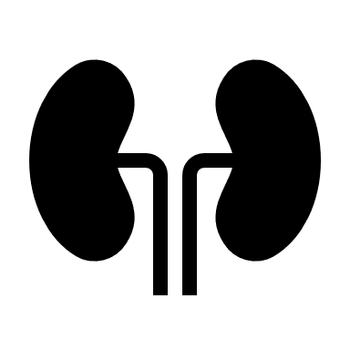
Methods
Measured clinical endpoints
Length of stay/ rehospitalisation
Medical or surgical complications
Prospective Database
Laparoscopic PD insertions for urgent dialysis identified
Demographic details collected
Renal replacement status after follow-up
3
Urgent PD
16-17 Sep 2021

Slide 4
Results
 | Reason required urgent PD
1 | Central vein stenosis
2 | Central line related sepsis
3 | Patient refusing HD line (no AVF options)
4 | Patient moving to area with limited HD access
10 Month period- total of 37 laparoscopic PD catheters inserted
11% (4 insertions) were for urgent PD
Mean follow-up | 153 Days (60-307)
Mean time from insertion to first PD flush | 3 Days (1-4)
Mean length of admission | 9.5 Days (3-17)
Readmission rate | No patients readmitted
Complications | 1 patient developed pneumonia as inpatient. 1 patient developed exit site infection as outpatient.
Long-term RRT | All patients currently remain on PD- none required HD
4
Urgent PD
16-17 Sep 2021
Notes:
4

Slide 5
Discussion
- Laparoscopic peritoneal dialysis catheter insertion is a safe and effective way to initiate PD for urgent renal replacement therapy (RRT)
- It aids in delivering planned renal replacement therapy and facilitates patient wishes regarding RRT
- As our case series demonstrates it has particular importance in patients
1.) With rapidly declining GFR or who have presented at ESRD who have insufficient time for AVF maturation
2.) Have potential central venous access issues such as line sepsis and central venous disease
- We hope to continue to add to this discussion through continued development of our prospective PD database in Northern Ireland
References
@CorrMP
5
Urgent PD
16-17 Sep 2021
Notes:
5

