Slide 1
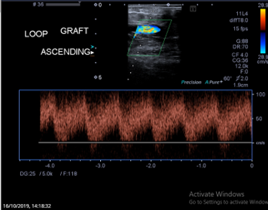
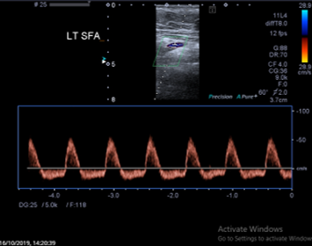
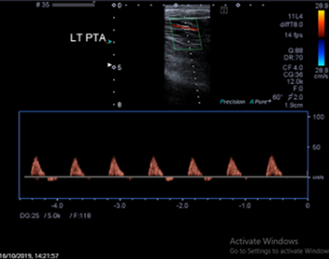
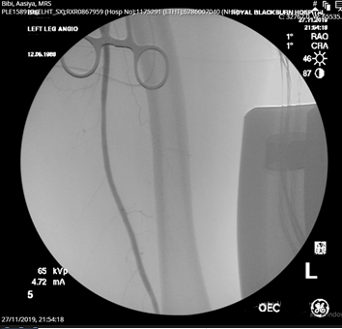
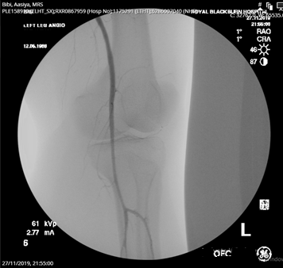
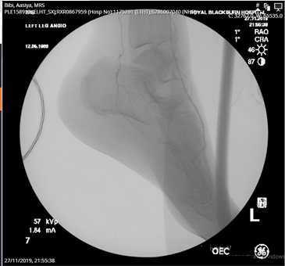
A rare case of Lower limb ischemic Monomelic Neuropathy
Ahmed Elmetwally MD, Mohamed Bashir MD. ,Haytham Al-khaffaf MD.
Background
Investigations
Conclusion
Ischemic monomelic neuropathy (IMN), is a rare complication, with some reporting between 0.3 to 5%.
First reported 1983 by Wilbourn, who defined it as a multiple axonal injury. Clinically, most of the patients will have a distal pulse; however, neurological clinical presentation suggests that ischemia is present.
Motor and sensory deficit rapidly develop.
Lack of experience is a culprit of reduced reporting and delayed diagnosis.
IMN usually occurs in diabetics and mostly in the upper limb.
IMN is a difficult diagnosis because of its primarily neurological presentation.
Early closure of the fistula can lead to partial or full restoration of the sensory and motor function.
Noninvasive vascular studies can be helpful in assessing distal perfusion in vascular steal syndrome but are only suggestive for diagnose IMN.
Nerve conduction study can be diagnostic, but care must be taken not to delay diagnosis.
One unanswered question is whether graft vs fistula is the main cause which increases the occurrence of such rare complication.
Duplex scan day one after loop creation, show no flow abnormalities with patent graft.
Method (Cont.)
O/E: Adequate distal triphasic waveform was demonstrated distally.
Investigation: MRI scan of the spine was performed to exclude spinal hematoma cord compression.
Immediately a diagnosis of IMN was concluded and fistula ligation was carried without a significant delay.
Full recovery of the motor and sensory power one month after follow up.
Method
A 50 years old female diabetic patient with chronic renal failure on dialysis who had exhausted all her upper limb access options, underwent a loop ePTFE loop femoral artery to vein graft under spinal anathesia.
Pre and post operative scans showed good flow. Immediately post operative the patient developed parathesis and motor weakness in her leg.
Investigations
Future research question
One unanswered question is whether graft vs fistula is the main cause which increases the occurrence of such rare complication.
Angiogram one month after the intervention
Notes:
.

